Slide 1

City Hotel Booking Analysis with Machine Learning

Slide 2

Agenda: Follow Crisp Dm (Data Mining)
01
02
03
04
05
06
Business Understanding
Data Understanding
Data Preparation
Modeling
Evaluation
Deployment
Select and apply various modeling techniques, adjusting and optimizing to develop the most suitable model
Assess the performance of the developed model
Implement the model into the business environment for practical use
Define the business problem, objectives, and the desired outcomes
Identify and describe the data to address the business problem
Clean, transform, and organize raw data into a suitable format for modeling

Slide 3




Business Understanding
City Hotel Business Model
City Hotel’s main source of income are customers booking rooms and checking in
Cost of the business model is customer canceling the reservation
Goal: Prediction + Improvement
W﻿e want to predict whether customer will cancel the reservation or not after reservation but before checking in
City Hotel can leverage data with most optimal model by focusing towards
Highest cost (FP): customers who don’t get seen by the hotel because they don’t want to cancel, but hotel cancels it
Focus on loyal customers (TN): those who doesn‘t cancel reservation before checking in
Better quality of service to loyal customers

Slide 4
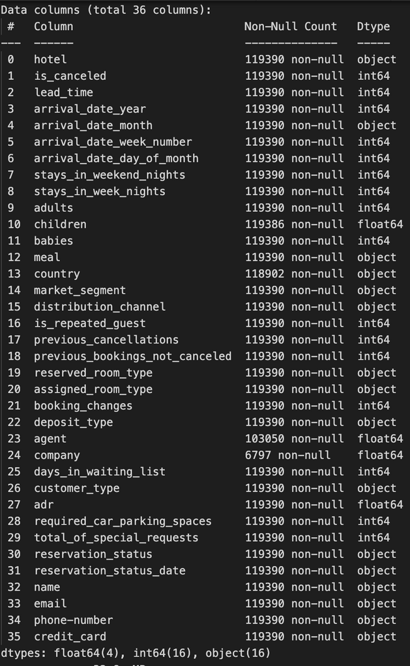
Data Understanding: dataset
Hotel Booking Demand Dataset
01
36 columns and 119,390 observations for a City & Resort Hotel
02
Mix of categorical and numeric variables
03
Single booking record per person that includes all relevant booking information
04
Target Variable: ‘is_canceled’
1 = Canceled booking
0 = Confirmed booking

Slide 5
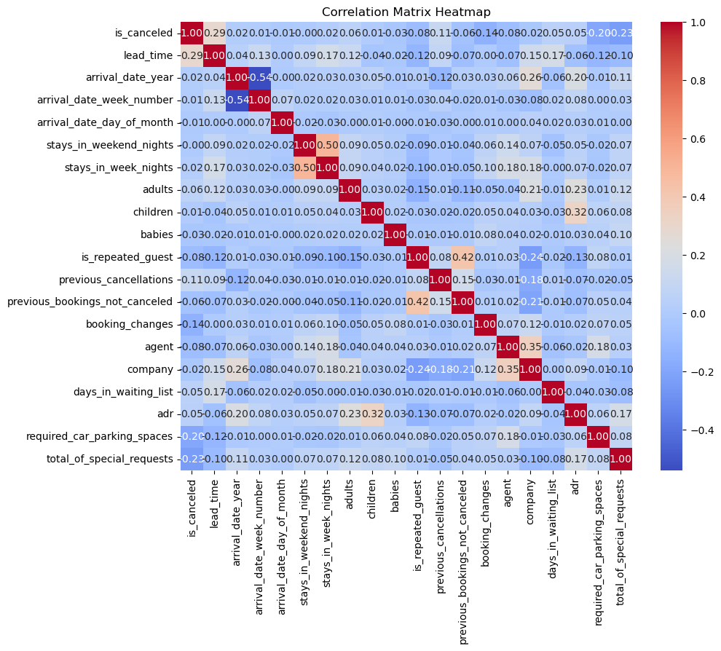
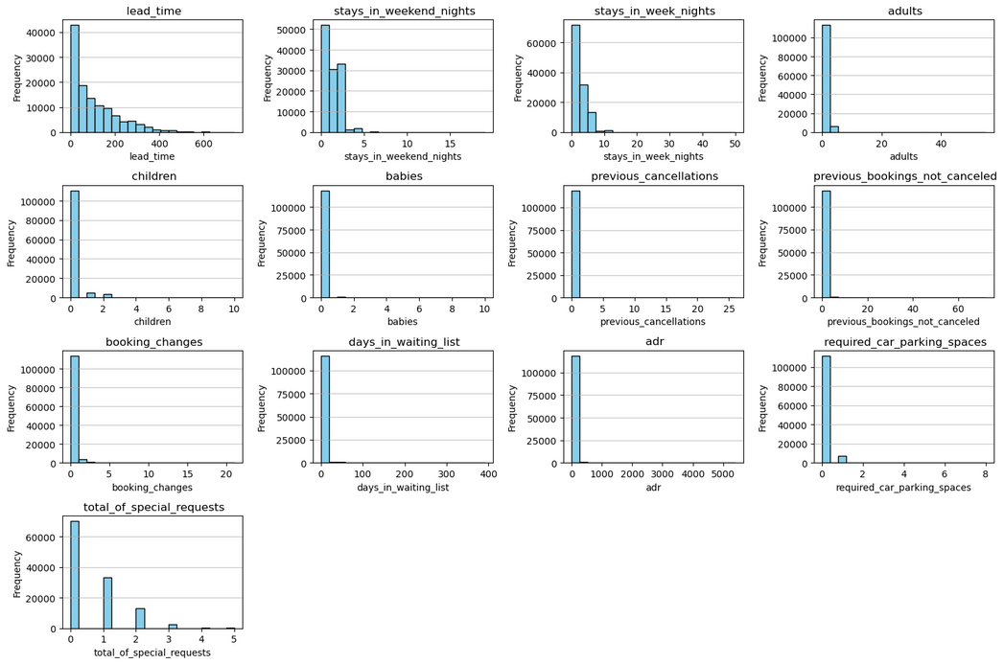
Data Understanding: Exploration of data

Slide 6
Data Preparation
01
Reduce Data Size
Drop ‘Resort Hotel’ (3000) and keep ‘City Hotel’ (7000).
Customer’s personal information: email, phone
Possible data leakage: post-booking information (e.g. reservation_status)
02
Drop Irrelevant Attributes
Handle missing values
& outliers
Drop 4 missing values from ‘children’ column - insignificant compared to whole data set
Drop outliers
03
04
Handle Ordinal & Non Ordinal Categorical Variables
Convert ordinal categorical values into numbers
One hot encoding categorical variables

Slide 7



Evaluation Metrics
Minimizing False Positives
Incorrectly predicting cancellations (FP) can lead to unnecessary costs and disruptions in hotel operations
Why F1 Score?
The F1 Score balances precision and recall, providing a more comprehensive view of model performance
Cost Implication
high number of FP → hotel might wrongly assume a booking will be canceled. → overbooking and loss of customer trust and satisfaction

Slide 8


Preparation before Modeling
Original Data Set
Data Set with New Features
Creating “X_initial” feature by removing certain columns on training set that are not necessary for the initial model training
Splitting our dataset into features X and target variable y. Splitting our dataset into training and testing sets using train_test_split (Train-test split 70:30)
kNN, Decision Tree, and Logistic Regression classifiers are trained and evaluated using 5-fold cross-validation
The new features contributed to better peformances
"is_holiday", "is_weekend", "got_reserved_room"
Create new column "date" by concatenating "arrival_date_year", "arrival_date_month", "arrival_date_day_of_month"
Create new column "is_holiday" out of "date" column
Create new column "is_weekend" out of "date" columns
Create new column "got_reserved_room" out of "assigned room type" and "reserved room type"
Notes:
Valerie - 2min

Slide 9
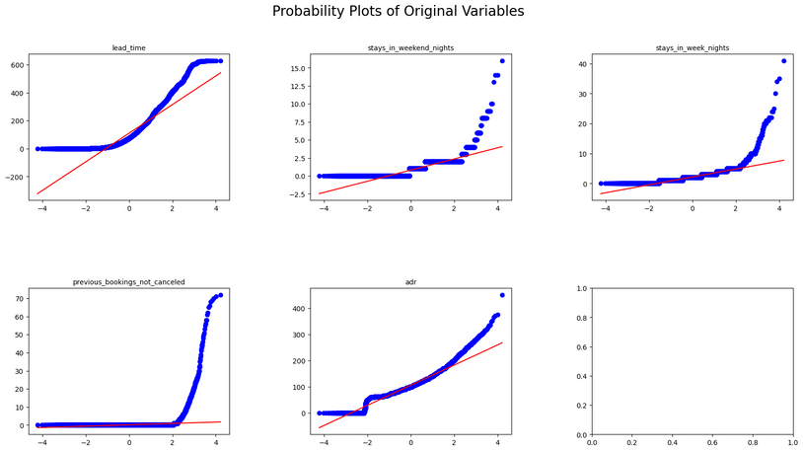
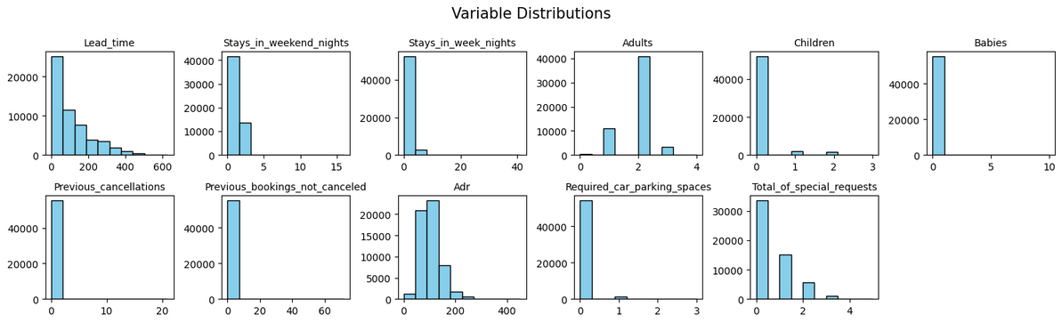
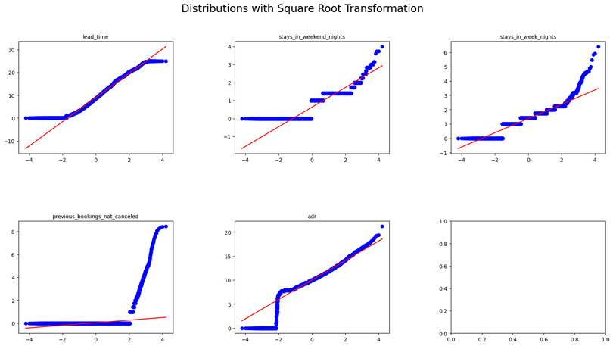
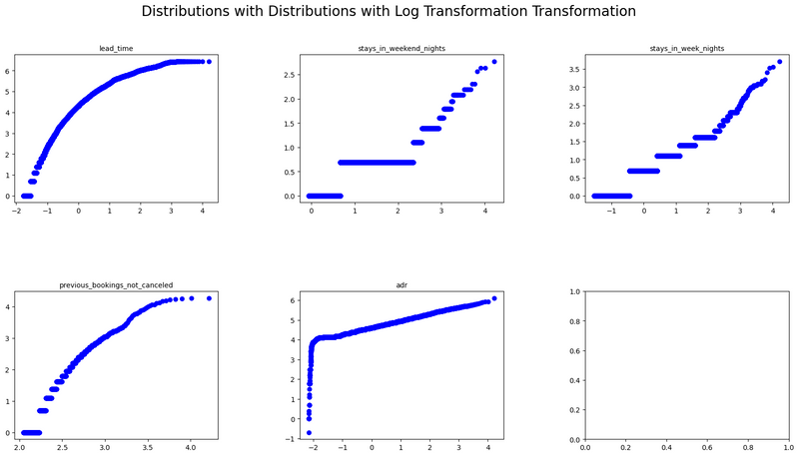
Models with Transformed Data
2. Create a probability plot for each variable in test_transform
Visualize the distributions of selected features in our dataset
Everything except 'adults' look not normal
The closer the points lie to the diagonal line, the more normally distributed the feature is.
3. Visualize the distributions of selected features after applying a Square Root transformation
4. Visualize the distributions of selected features after applying a Log transformation
sqrt = ['lead_time','adr']
log = ['stays_in_weekend_nights','stays_in_week_nights','previous_bookings_not_canceled']
Notes:
Valerie

Slide 10

Cross Validations Performances
--Before and After Feature Engineering
 | Initial Performance (F1) | Performance with New Features (F1) | Performance with Features and Transformation
kNN | 0.77 (+/- 0.00) | 0.77 (+/- 0.01) | 0.77 (+/- 0.01)
Decision Tree | 0.76 (+/- 0.01) | 0.77 (+/- 0.01) | 0.77 (+/- 0.01)
Logistic regression | 0.72 (+/- 0.01) | 0.73 (+/- 0.01) | 0.74 (+/- 0.01)
Notes:
Valerie

Slide 11
Hyperparameter Tuning
Model | Non-Nested CV F1 Score | Optimal Parameters | Nested CV F1 Score (Mean) | Nested CV F1 Score (Std Dev)
kNN | 0.8067 | {'n_neighbors': 21, 'weights': 'distance'} | 0.8067 | ±0.0031
Decision Tree | 0.7778 | {'criterion': 'entropy', 'max_depth': None, 'min_samples_leaf': 1, 'min_samples_split': 3} | 0.7771 | ±0.0057
Logistic Regression | 0.7448 | {'C': 1000, 'penalty': 'l2'} | 0.7445 | ±0.0054

Slide 12
Evaluation
Classification Report
kNN Traning Set
kNN Test Set
DT Traning Set
kNN Traning Set | precision | recall | f1-score
0 (Not Canceled) | 0.99 | 1.00 | 0.99
1 (Canceled) | 0.99 | 0.98 | 0.99
accuracy | - | - | 0.99
kNN Test Set | precision | recall | f1-score
0 (Not Canceled) | 0.85 | 0.91 | 0.88
1 Canceled) | 0.86 | 0.78 | 0.82
accuracy | - | - | 0.85
DT Traning Set | precision | recall | f1-score
0 | 0.97 | 1.00 | 0.98
1 | 0.99 | 0.95 | 0.97
accuracy | - | - | 0.99
Logistic Traning Set
Logistic Test Set
DT Test Set
Log Traning Set | precision | recall | f1-score
0 | 0.79 | 0.92 | 0.85
1 | 0.86 | 0.66 | 0.75
accuracy | - | - | 0.81
Log Test Set | precision | recall | f1-score
0 | 0.79 | 0.92 | 0.85
1 | 0.86 | 0.66 | 0.75
accuracy | - | - | 0.81
DT Test Set | precision | recall | f1-score
0 | 0.84 | 0.86 | 0.85
1 | 0.80 | 0.78 | 0.79
accuracy | - | - | 0.82

Slide 13
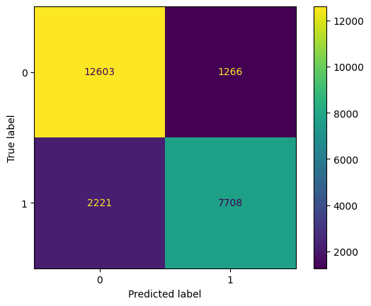
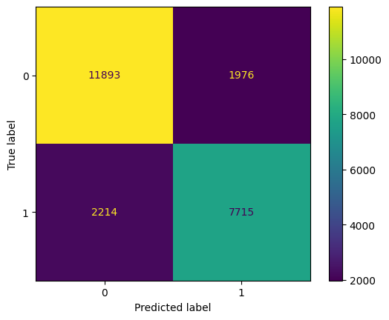
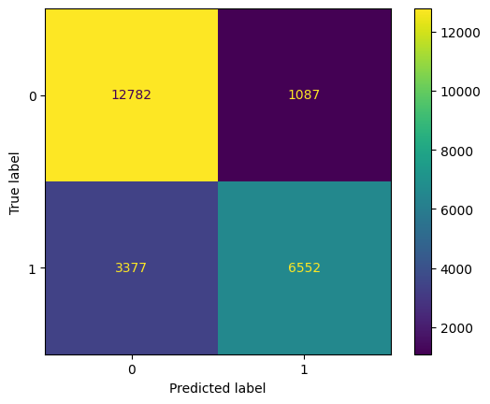
Evaluation
Confusion Matrix
Confusion matrices are plotted for the test set predictions of each model, visually representing the performance of each classifier
kNN
Decision Tree
Logistic Regression
FP = 5.3%
FP = 8.3%
FP = 4.6%

Slide 14
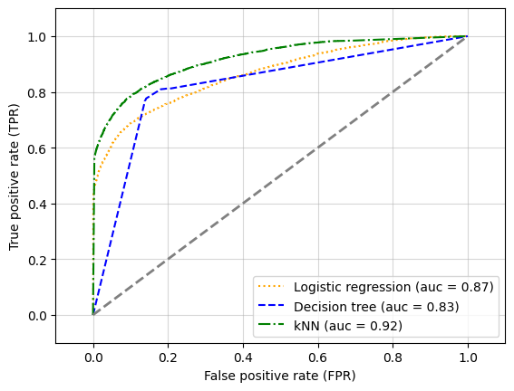
Evaluation
ROC
Performing 5-fold cross-validation to evaluate the ROC AUC performance of Logistic Regression, Decision Tree, and k-NN classifiers on the test data
Visualizing the ROC curves of the classifiers, indicating their performance in distinguishing between the positive and negative classes. (FPR, TPR)
The AUC for each classifier is also computed and displayed in the legend of the plot.
Model type | ROC AUC
kNN | 0.90 (+/- 0.01)
Decision Tree | 0.80 (+/- 0.01)
Logistic regression | 0.87 (+/- 0.01)

Slide 15
EV of Outcomes: Cost/Benefit Matrix
 | Predict Customer canceling | Predict Customer not canceling
Customer actually canceling | $0 | -$0.015
Customer actually not canceling | $0 | $50-$0.015 = $49.985 ROI
Business Case to project expected improvement (ROI):
Let’s assume it costs us $0.015 to advertise a customer who ends up canceling their reservation and we also advertise to a customer who doesn’t cancel their reservation. The hotel earns revenue of $50 when a customer doesn’t cancels.
Total EV = (PTN​⋅$0) + (PFP​⋅−$0.015) + (PFN​⋅$0) + (PTP​⋅$49.985)
= $44.985

Slide 16



Deployment
Usage | Application | Result
The predictive model can be used to determine if the next customer will cancel the reservation or not | Develop or strengthen packages for loyal customers Make profit from selling this package + model deployment to other smaller hotels Develop customer retain packages for unloyal customers | Existing customers would be more satisfied with the hotel’s effort in strengthening their loyalty packages Competitive advantage to grab stakeholder’s attention in hospitailty and tourism industry

